Slide 1
secure data hiding in images using steganography
CAPSTONE PROJECT
Presented By:
Student Name : PAKKIRAPPAGARI DIILEEPP KUMAR
College Name & Department : ANURAG UNIVERSITY , CSE

Slide 2
OUTLINE
Problem Statement
Technology used
Wow factor
End users
Result
Conclusion
Git-hub Link
Future scope

Slide 3
Problem Statement
Data security and privacy are major concerns in the digital era. Traditional encryption methods can be detected and targeted, making them vulnerable to attacks. There is a growing need for a discreet way to hide sensitive information within images to ensure secure communication. Steganography provides an effective solution by embedding messages in images without causing noticeable changes, making it a valuable technique for covert data transmission.

Slide 4
Technology used
Programming Language: Python
Libraries: OpenCV, NumPy, OS
Concepts: Image Processing, ASCII Encoding, Steganography
Hardware Requirements: Any system capable of running Python

Slide 5
Wow factors
Invisible Communication: Messages are hidden within images without noticeable distortion.
Simple Yet Effective: Uses basic image manipulation to encode messages.
Custom Encryption: Message retrieval is secured with a password.
Practical Application: Can be used in cybersecurity, digital forensics, and secure messaging.

Slide 6
End users
Cybersecurity Professionals
Journalists & Whistleblowers
Digital Forensics Experts
Military & Intelligence Agencies
General Users Concerned About Privacy

Slide 7
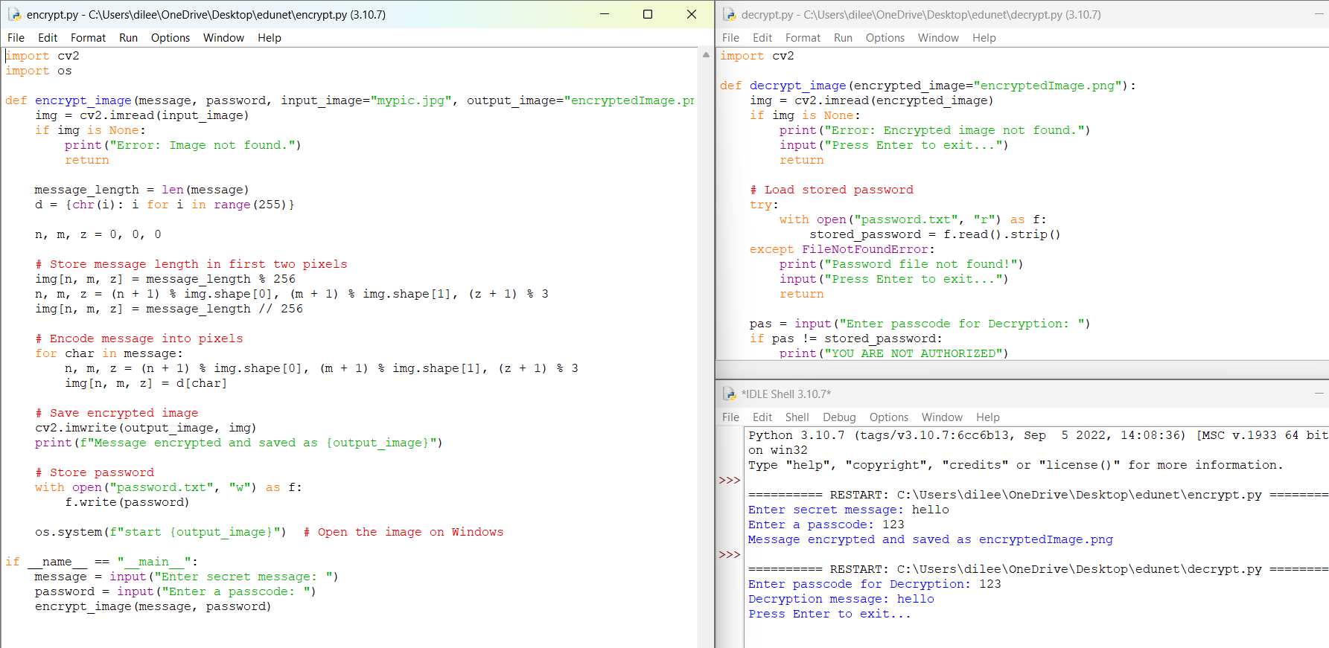
Results

Slide 8
Conclusion
Steganography provides a covert method of data transmission.
The implementation showcases a simple yet effective proof of concept.
Future improvements can enhance security and efficiency.

Slide 9
GitHub Link
https://github.com/dilip2003reddy/Aicte-project.git

Slide 10
Future scope(optional)
Implementing LSB (Least Significant Bit) Steganography for higher security.
AES Encryption before embedding to enhance protection.
Multi-format Support: Extend support to audio and video files.
GUI Integration for user-friendly access.
Machine Learning to detect and counteract steganalysis attacks.

Slide 11
THANK YOU

